Slide 1
Roid Rage
Group Feedback Week

Slide 2
Scrolling score attack shooter based upon Galaga
Programmer Monkey 1: Steve Hutchison
Programmer Monkey 2: Liam Jeffry
Technical Advisor: Thomas Hope
Gameplay Designer: Max Kidd
Lead Artist: Paul Kidd

Slide 3
Player controls a small ship starting at the bottom of the screen
Defeating enemies rewards the player with power-ups and health
Bosses frequently appear and demand the players attention

Slide 4
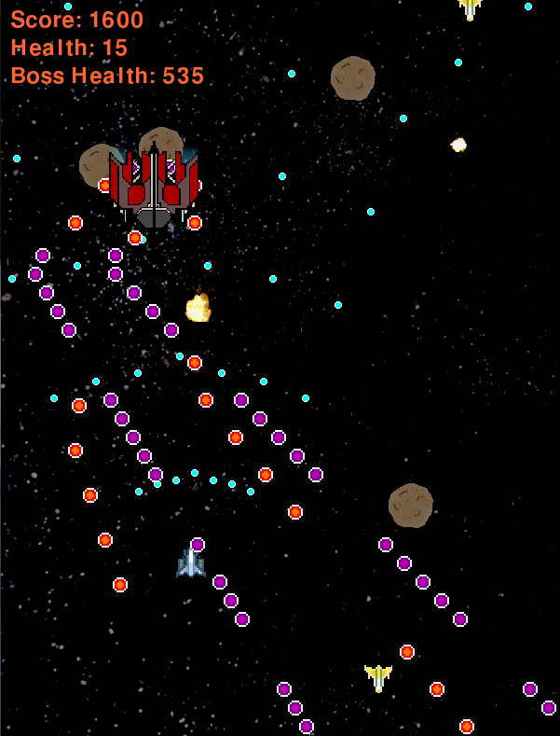






Power up based gameplay

